Slide 1

Simulator-Aware Runtime Prediction for Quantum Circuits
QUANTUM RINGS RUNTIME CHALLENGE · IQC 2026
Predicting tensor-network simulation time straight from the circuit file without running it
The Polylogs
Lucas Patten · Nathan Galley · Adam Armstrong · Bryce Hedelius
Brigham Young University · Utah Valley University
Notes:
Team 'The Polylogs'. The task: given a QASM circuit and a simulator threshold, predict how many wall-clock seconds the Quantum Rings simulator will take — without running it.

Slide 2
The Problem
PART ONE
1
Predict a simulator's wall-clock runtime from the circuit alone.

Slide 3
The task: predict runtime without running the circuit
.qasm circuit
+ simulator threshold χ
→
extract features
pure text regex
→
our model
features + threshold
→
predicted runtime (seconds)
predict ≥ 21,600 s ⇒ “timeout”
532 quantum circuits
~2600 labeled runs
6 h total runtime
≤ 15 s required execution speed
Notes:
Threshold is a model input, not a constant: the same circuit runs longer at a higher threshold. Timeouts are folded into the same metric — predict >= the cap to 'call a timeout'.

Slide 4
Initial observations: no single trait carries it
We looked at correlations between circuit traits and runtimes (log₁₀ duration).
Single features stall
1
Strongest single trait (threshold)
R² ≈ 0.13
2
Best linear combination of all traits (up to size 9)
R² ≈ 0.50
3
Liveness (how often a qubit is used) is important!!!
100% of combos
No flat feature explains more than half the variance.
Notes:
This is the pivot: the target is a product of an operations factor and an entanglement/threshold factor, which is exactly what flat correlations and axis-aligned trees cannot represent.

Slide 5
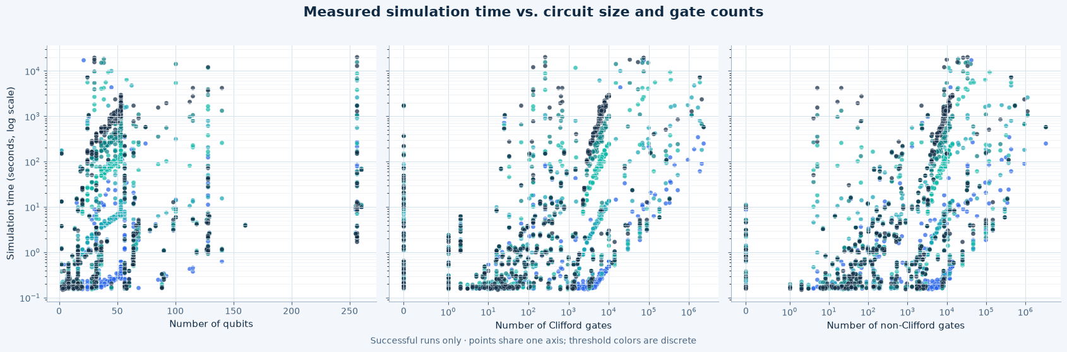

Initial observations: no single trait carries it
We looked at correlations between circuit traits and runtimes (log₁₀ duration).
Notes:
This is the pivot: the target is a product of an operations factor and an entanglement/threshold factor, which is exactly what flat correlations and axis-aligned trees cannot represent.

Slide 6
What actually drives runtime
PART TWO
2
The simulator is a tensor network — the exponential hides in the bond dimension.

Slide 7
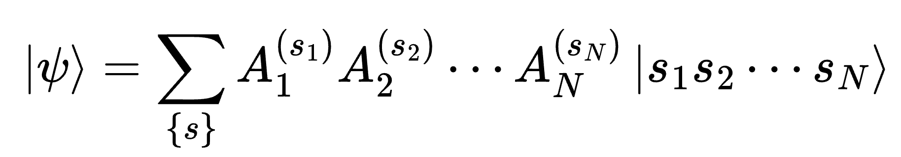
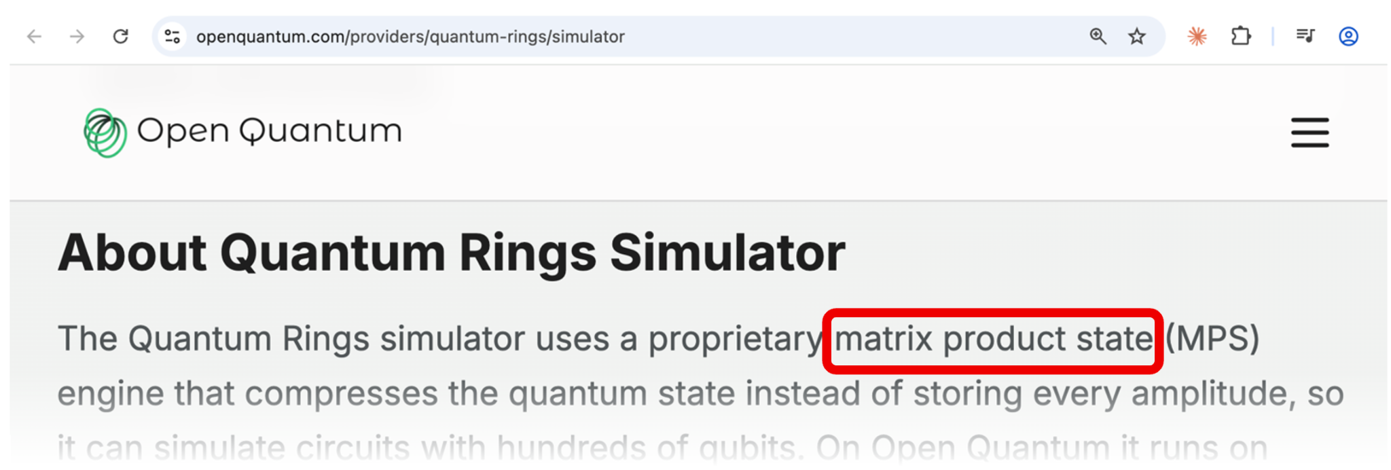
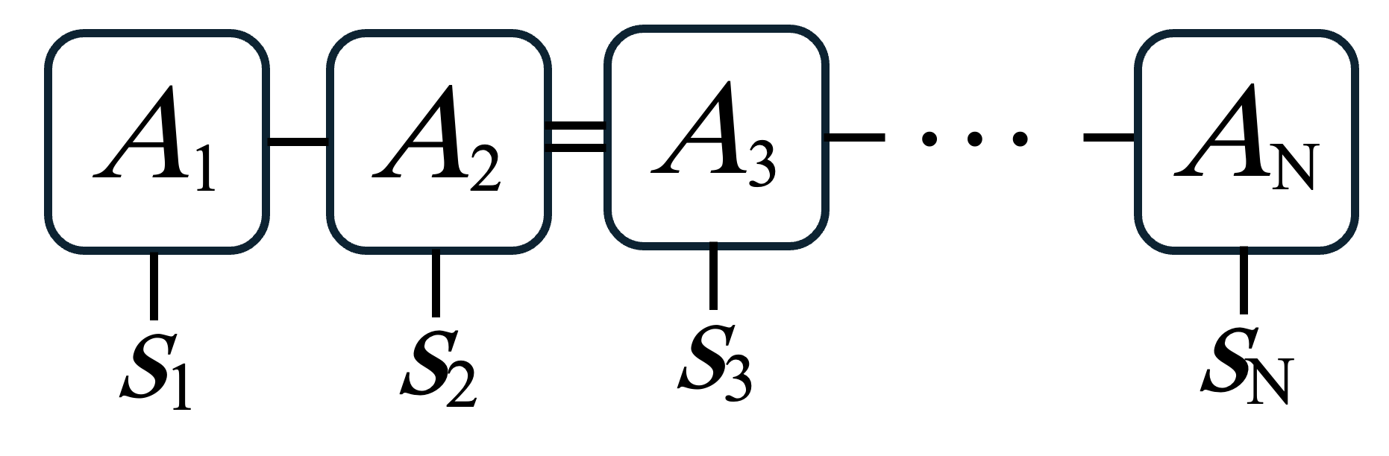
Key insight: it is an approximate tensor-network (MPS) simulator
Not a state-vector engine. Quantum Rings compresses the state as a matrix-product state (MPS) and truncates it.
Matrix-product state
runtime ≈ (operations) × (χ-blow-up, capped by threshold)
MPS contraction cost ∼ n · χ³ — going threshold 16→512 can blow runtime up ~10⁴×
Each tensor Aᵢ carries a bond index of size ≤ χ; the exponential cost lives in that bond, not the qubit count.
Notes:
Evidence the engine is MPS: the Open Quantum provider page, plus a trained paper (Xing et al.) calling it the Quantum Rings tensor-network simulator. The threshold column is the bond-dimension cap.

Slide 8
Why structure gives only a ceiling, not the runtime
The interaction graph bounds difficulty (contraction cost ~ 2^treewidth) — but the real cost sits below it, for reasons the graph cannot see.
✕
Gottesman–Knill
✕
Gate angles
Clifford circuits (H, S, CNOT) can be densely wired, with large treewidth, and still simulate quickly.
CRZ(θ→0) ≈ identity (if angles are small, we don’t get much entanglement → things can be truncated).
✕
Truncation is numerical
✕
Treewidth is NP-hard
Finding the actual χ requires running the circuit itself, so things must be done heuristically
Exact treewidth is intractable, and heuristic estimates are a weak upper bound that can blow the per-circuit time budget.
The residual below the ceiling is irreducibly numerical — which is why runtime prediction is a machine-learning problem, not a formula.

Slide 9
Our model
PART THREE
3
Two factors of features, and the model class that can combine them.

Slide 10
Feature engineering: 32 extracted features
Volume & operations
Interaction geometry (χ)
Gate character (χ)
Gate count, depth, qubit count
1q / 2q / multi-qubit counts
CNOT count, T-gate count
Swap-distance span (sum / max / mean)
2-qubit depth
...
Interaction-graph edges & density
Peak / mean qubit degree
Bisection cut
Reordered edge span (RCM)
Connected components
...
Non-Clifford & 2-qubit fraction
Near-identity fraction
Entangling capacity, mean angle
Angle entropy, Clifford-grid frac
Degree CV, layer periodicity
...
Pruned ~100 → 32. Some features were redundant or not helpful, so they were pruned.
Notes:
The feature set is organized by the cost model on purpose. Operations are cheap and structural; the chi factor is what the graph misses, approximated cheaply via gate-type mix and angle statistics.

Slide 11
Rigor & engineering
✓
Leakage-free validation
✓
Cross-model validation
Grouped 10-fold CV (GroupKFold by circuit): every circuit's rows stay in one fold, so no threshold of a circuit can leak between train and test.
The MLP ensemble lands within a few points of TabPFN on identical folds — the result is a real signal, not a single-model artifact.
✓
Speed budget met
✓
Text-based parsing
≤ 15 s / circuit. TabPFN n_estimators=4 keeps predict ~8 s; the MLP predicts in milliseconds and is the self-contained submission fallback.
Matching algorithm parses circuit features.
Notes:
Featurization was parallelized ~4x with a reliable serial fallback (macOS spawn deadlock in one session).

Slide 12
Results & honest limits
PART FOUR
4
Where we land, where we are weak, and what we chose not to do.

Slide 13
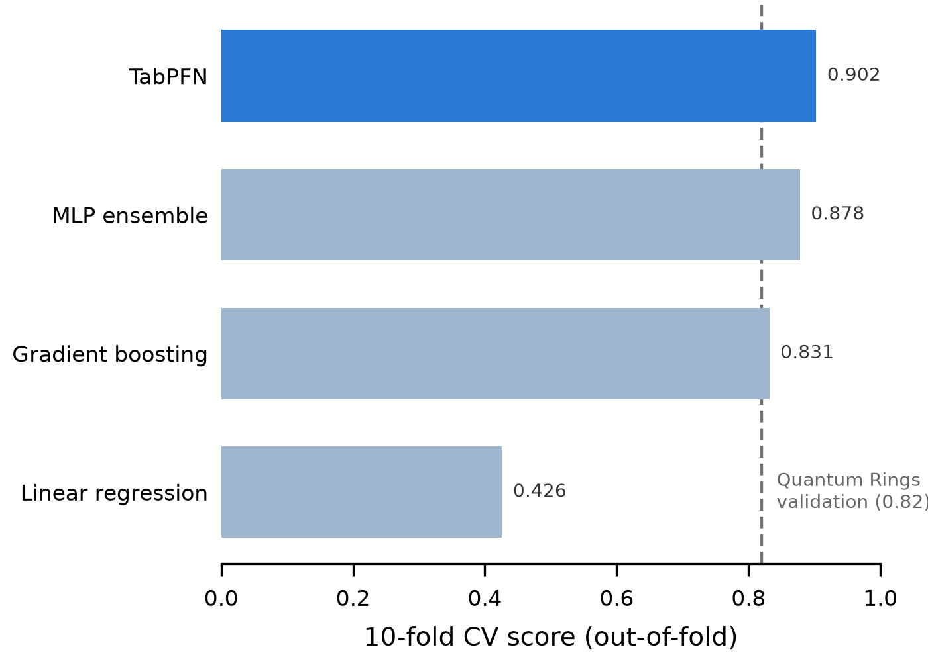
Why TabPFN: accuracy varies with model class
Why TabPFN wins
A pretrained tabular transformer with a Bayesian in-context prior — built for the small-data regime. This problem is data-limited, which is why this model performs well for the scenario.
Notes:
The gap from boosting (0.82) to TabPFN (0.90) dwarfs any single feature delta. The MLP ensemble at 0.88 is our safe, self-contained submission fallback (sklearn only, predicts in ms).

Slide 14
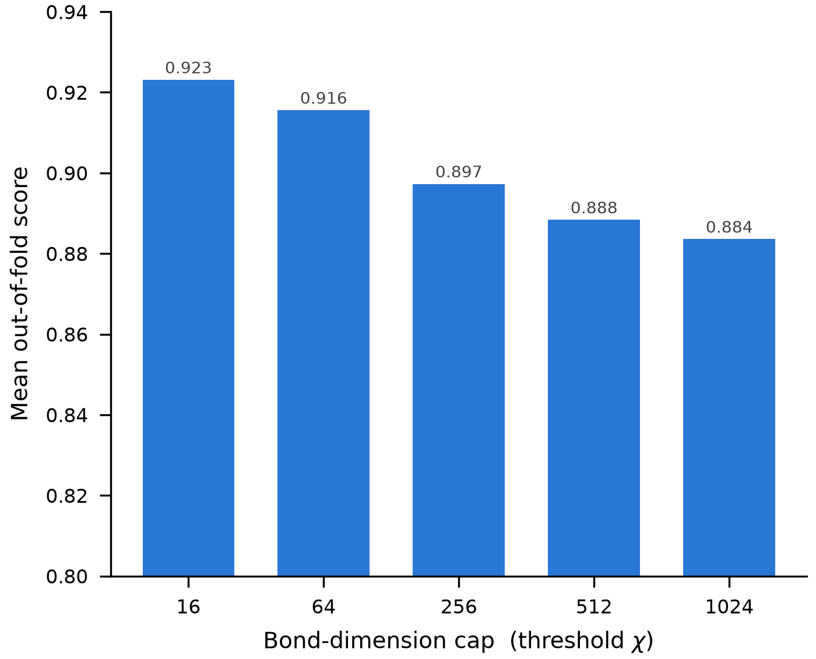
Honest limits: measuring entanglement cheaply is the wall
As threshold increases, measuring entanglement becomes more difficult, and the accuracy somewhat decreases.
Notes:
This slide carries the 'handling challenges' story: we chased the hard residual, measured it honestly, and stopped when the cost outran the gain.

Slide 15
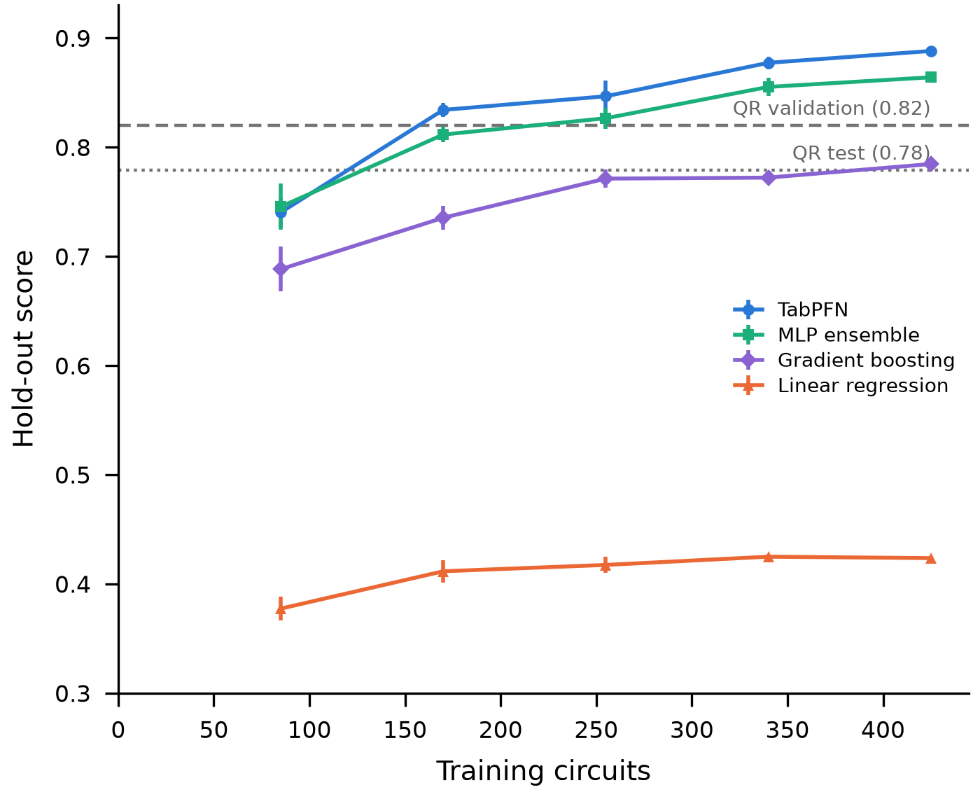
A data-limited regime
Still rising at full data
The last 85 circuits add +0.011, well above the ±0.003 feature-noise floor.
Thus, we can expect the model to become more accurate with more data.
Notes:
The 0.888 is below the pooled 10-fold CV (0.903) because it trains on 80% and tests on fully held-out circuits. It is the honest preview of the competition hold-out; expect some gap.

Slide 16
Takeaways
1
runtime ≈ operations × χ-cost
The simulator is MPS; threshold is the bond-dimension cap. Two factors, one product surface.
2
Structure is a ceiling, not the answer
Clifford, gate angles, and spectrum decay make the real cost a numerical property — so it is an ML problem.
3
Model class is important
TabPFN 0.90 ≫ gradient boosting 0.82 on identical features; a small-data prior fits a data-limited problem.

